Slide 1
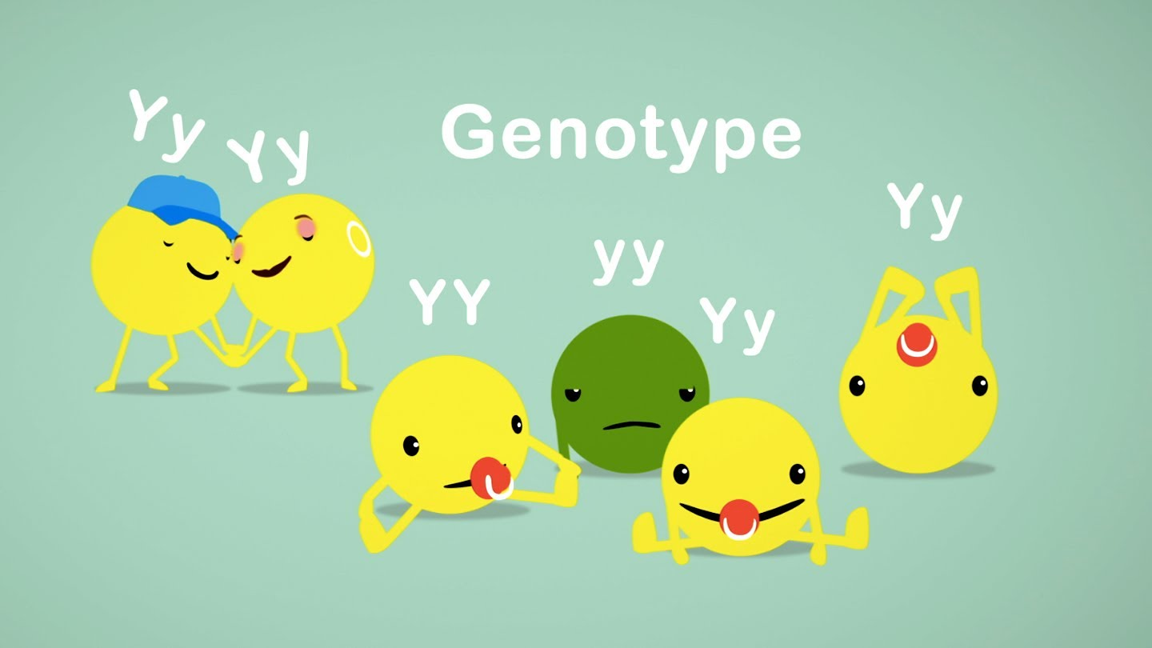
Predict and interpret patterns of inheritance in sexually reproducing organisms.
4.2 a

Slide 2
Heredity
The passing of characteristics from parent to offspring

Slide 3
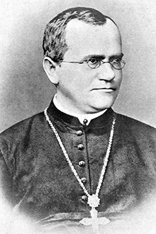
Gregor Mendel “Father of Genetics”
late 19th century
experiments with garden peas
Austrian monk
described the patterns of inheritance
significance of work recognized in 20th century
Didn’t know “Gene”

Slide 4
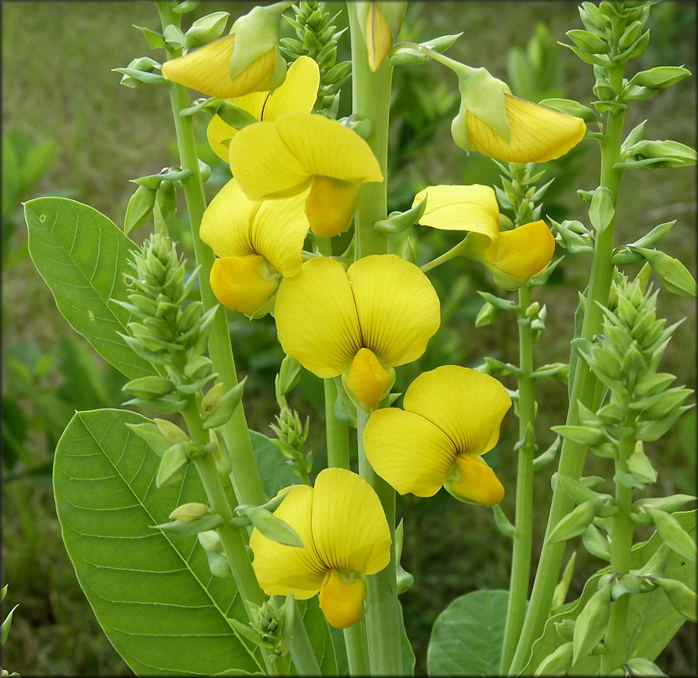
Artificial Fertilization
transferring pollen from the male part of one flower to the female part of another flower.
seeds will grow into plants with a desired trait
Example: yellow flowers.

Slide 5
Blending Inheritance
What people thought during Mendel’s time
Offspring are a "mix" of their parents
Example: if a pea plant had one short parent and one tall parent, that pea plant would be of medium height. The offspring would then pass on heritable factors for medium sized offspring.

Slide 6
Mendel Studied Pea Plants
Flower Color | Flower Position on Stem | Stem Length | Pod Shape | Pod Color | Seed Shape | Seed Color
Violet-red (Purple) | Axial | Tall | Inflated | Green | Round | Green
White | Terminal | Short | Constricted | Yellow | Wrinkled | yellow
They grow fast!!!

Slide 7
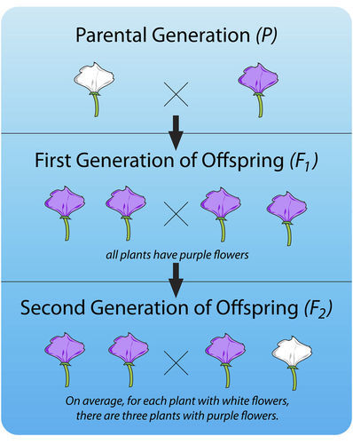
Experiment #1

Slide 8
Law of Segregation
F1-characteristic disappeared
F2- characteristic showed up again (75%)
There are two factors controlling a given characteristic
One dominates
These factors separate and go to different gametes

Slide 9
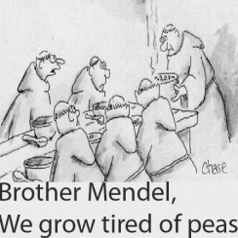
4.2 b

Slide 10
Experiment #2
Are different characteristics inherited together?
example, are purple flowers and tall stems always inherited together?

Slide 11
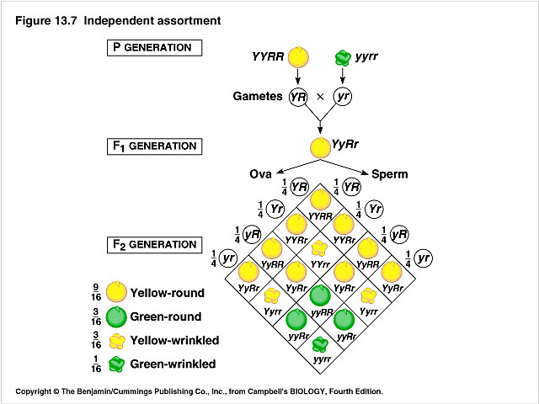

Slide 12
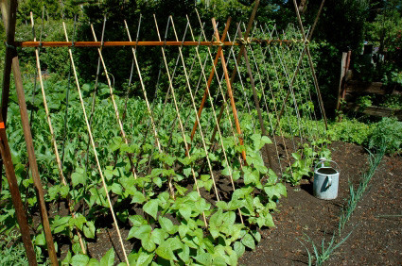
Law of Independent Assortment
factors controlling different characteristics are inherited independently of each other.

Slide 13
Probability
If a parent has one dominant and one recessive factor for a trait, then half the time the dominant factor will be passed on, and half the time the recessive factor will be passed on.
Mendel observed 3:1 dominant: recessive in his F2 generation

Slide 14
Linked Genes on Chromosomes
Linked Genes- genes that are close together on a chromosome, and are packaged into the gametes together.
tend to be inherited together because they are located on the same chromosome.

Slide 15
Punnett Squares
a chart that allows you to easily determine the expected percentage of different genotypes in the offspring of two parents.
Heterozygous means that there is one dominant allele and one recessive allele.
Homozygous means that the alleles are the same; either both are dominant or both are recessive.
A dominant allele shows up ¾ of the time.
A recessive allele shows up ¼ of the time.
The gametes produced by the male parent are at the top of the chart, and the gametes produced by the female parent are along the side.
The different possible combinations of alleles in their offspring are determined by filling in the Punnett square with the correct letters (alleles).

Slide 16
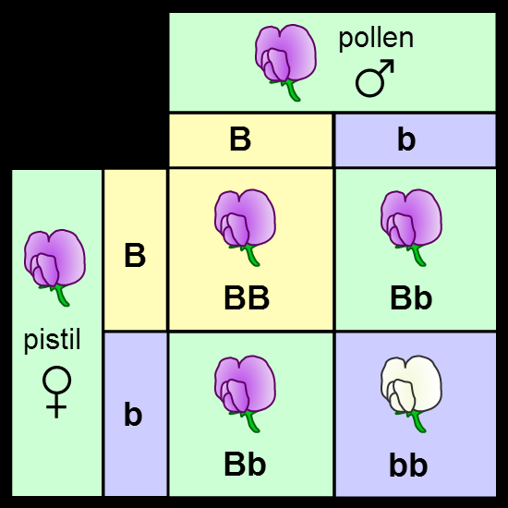

Slide 17
Genotypes and Phenotypes
Genotype- genes that are inherited from parents
represented by letters, one letter for each gene
Phenotype-physical expression of the genotype
Example: a phenotype would be eye color.

Slide 18
Prediction Offspring Phenotypes
You can predict the percentages of phenotypes in the offspring of this cross from their genotypes.
B is dominant so BB or Bb genotype will have the purple-flower phenotype.
bb genotype will have the white-flower phenotype.
three out of four (75 percent) have purple flowers and one out of four (25 percent) have white flowers.
These are the same percentages that Mendel got in his first experiment.

Slide 19
What are the missing Genotypes?
White flowered plant
Purple Flowered Plant

