Slide 1
Reproduction
4.1

Slide 2
1 parent or 2?
Sexual reproduction just means combining genetic material from two parents.
Asexual reproduction produces offspring genetically identical to the one parent.

Slide 3
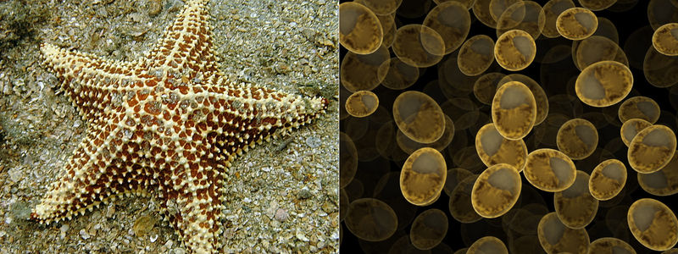
Asexual Reproduction
single parent
offspring that are genetically identical to each other and to the parent (clones)
Prokaryotes and some eukaryotes
Examples: binary fission,
fragmentation, and budding.

Slide 4
sexual Reproduction
two parents
offspring that are a genetic combination of the parents
produces reproductive cells (gametes- sperm, egg, pollen, ovules)
Gametes-
haploid cells (n) (half the # of chromosomes)
Produced by meiosis
Fertilization- 2 gametes unite and make a zygote
Zygote-
diploid cell (2n) (twice the # of chromosomes of a gamete)
Example: Human Gamete- 23 Chromosomes
Human Zygote- 46 Chromosomes

Slide 5
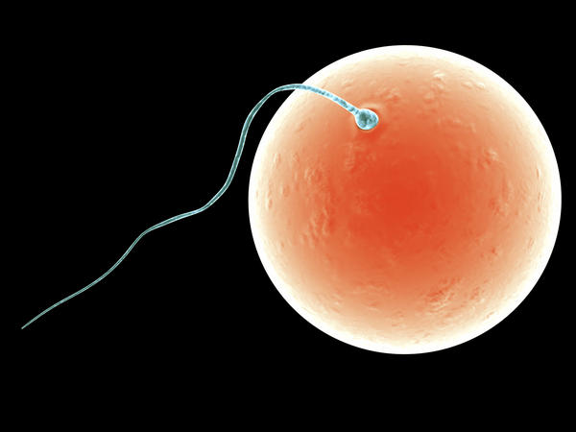
Sexual Reproduction

Slide 6
Advantages/Disadvantages
Advantages are in red
Asexual Reproduction | Sexual Reproduction
Single individual is the sole parent | Two parents give rise to offspring
Single parent passes on all its genes to its offspring | Each person passes on half its genes, to its offspring.
Offspring are genetically identical to the parent. | Offspring have a unique combination of genes inherited from both parents
Genetically identical individual. Genetic differences only occur as a result of mutations, which is a change in DNA | Results in greater genetic variation; offspring vary genetically from their siblings and parents.
Reproduction is quick. | Reproduction is time consuming

Slide 7
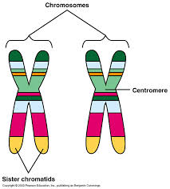
Homologous Chromosomes
very similar, not identical
separated when gametes are formed
gametes have only 23
chromosomes, not 23 pairs

Slide 8
Purpose of Meiosis
genetic variation

Slide 9
Meiosis 1
Where genetic variation is introduced
The pairs of homologous chromosomes are separated from each other.
Prophase1
homologous chromosomes line up together.
Crossing Over (exchange of DNA between homologous chromosomes making new allele combinations)
**Allele-gene that codes for different variations of the same trait
spindle fibers form, chromosomes condense and coil up tightly, nuclear envelope disappears.

Slide 10
Metaphase 1
Homologous chromosomes line up in their pairs in the middle
Chromosomes (mother’s or father’s) attach to either
side of the spindle randomly.
**random alignment- all of the chromosomes from the
mother or father do not end up in the same gamete

Slide 11
Anaphase 1
homologous chromosomes separate as the spindle shortens, they move to opposite sides of the cell.

Slide 12
Telophase
spindle fibers dissolve
After cytokinesis there are 2 haploid cells

Slide 13
Meiosis 2
sister chromatids are separated (gametes are generated)
results in four genetically unique haploid gamete cells

Slide 14
Meiosis 2
Prophase II: The chromosomes condense.
Metaphase II: The chromosomes line up one on top of each other along the middle, spindle is attached to the centromere of each chromosome
Anaphase II: The sister chromatids separate as the spindle shortens and move to opposite ends of the cell.
Telophase II: A nuclear envelope forms around the chromosomes in all four cells.
CYTOKINESIS- 4 haploid, unique daughter cells

